Slide 1

Tiny Encryption Algorithm (TEA) Benchmarking on the Raspberry Pi 3B+
California State Polytechnic University, Pomona
College of Engineering
Department of Electrical and Computer Engineering
Sydney Cady, Ryan Schwartz, Steven Yu, Mohamed El-Hadedy Aly
Notes:
Hello everyone, we will be discussing the tiny encryption algorithm, otherwise known as tea, and discussing its metrics shown on the raspberry pi 3b+. This research was done at cal poly Pomona, college of engineering under dr. Mohamed aly. Im Sydney cady

Slide 2
Tiny Encryption Algorithm (TEA) Benchmarking on the Raspberry Pi 3B+
California State Polytechnic University, Pomona
College of Engineering
Department of Electrical and Computer Engineering
Sydney Cady, Ryan Schwartz, Steven Yu, Mohamed El-Hadedy Aly
Notes:
RYAN: “Im Ryan Schwartz”

Slide 3
Tiny Encryption Algorithm (TEA) Benchmarking on the Raspberry Pi 3B+
California State Polytechnic University, Pomona
College of Engineering
Department of Electrical and Computer Engineering
Sydney Cady, Ryan Schwartz, Steven Yu, Mohamed El-Hadedy Aly
Notes:
STEVEN: I’M STEVEN YU

Slide 4
Tiny Encryption Algorithm
What is TEA?
TEA is a simple block cipher designed by David Wheeler and Roger Needham at the Cambridge Computer Laboratory.
Designed to encrypt and decrypt data for security purposes.
TEA scrambles plaintext based on a key so that it becomes unreadable without the key.
Operates on two 32-bit unsigned integers (one 64-bit data block).
Has a 128-bit key size.
Typically runs 64 Feistel rounds (32 cycles).
Notes:
STEVEN: This a brief introduction to the Tiny Encryption Algorithm or TEA.
TEA is a simple block cipher program in cryptography
It is designed to encrypt and decrypt data for security purposes, meaning it allows trusted people and devices to access the information while preventing unwanted access by hackers and such from stealing it.
TEA does this by scrambling the information using a key so that it becomes unreadable to those who do not know the key.
TEA operates on two 32-bit unsigned integers or one 64-bit data block of information.
It uses a 128-bit key.
And the encryption process runs 64 Feistel rounds or 32 cycles to finish the job.

Slide 5
Objective
Hardware: Raspberry Pi 3B+
Software: TEA.py, TEA.cpp
Executing the TEA written in Python and the TEA written in C++ on a Raspberry Pi 3B+ to measure and compare their performance metrics.
Collected measurements will to determine the efficiency of data encryption algorithms and optimize them for use on IoT devices.
Performance metrics: CPI, MIPS, execution time, and power consumption
Notes:
STEVEN: I will go over the objective of this study.
We are running 2 implementations of TEA, one written in Python and another in C++ on a Raspberry Pi 3B+ with a ARM Cortex-A53 processor.
Both implementations of TEA will be individually executed on the Raspberry Pi and metrics of their performance will be collected and compared.
The performance metrics include CPI, MIPS, execution time and power consumption.
Doing this analysis will allow us to determine the efficiency of data encryption algorithms like TEA.
It will ultimately help us optimize programs to increase the efficiency of encryption algorithms in IoT devices.

Slide 6
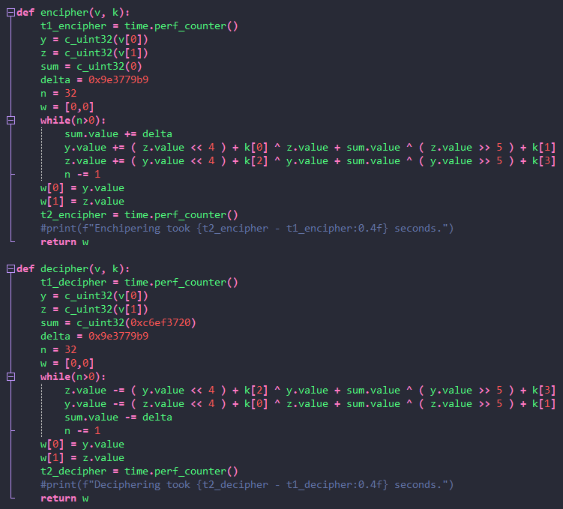
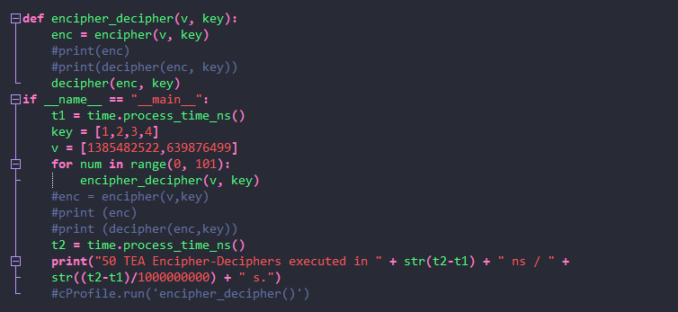
TEA in Python
Notes:
RYAN

Slide 7
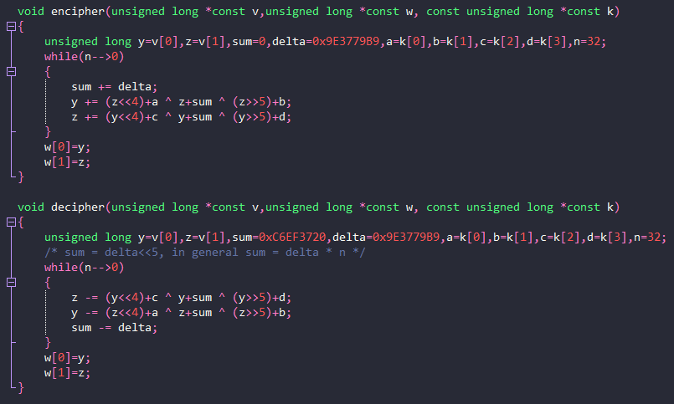
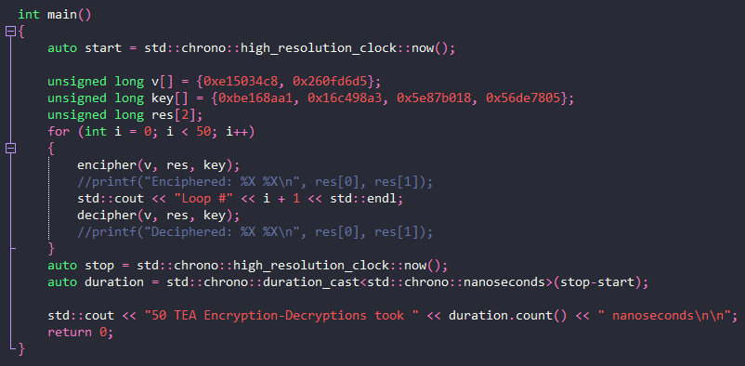
TEA in C++
Notes:
RYAN

Slide 8
Code Description
The source code can be divided into a Encipher method, Decipher method, and Main driver program.
The Encipher method accepts two 32 bit blocks of data and a 128 bit key from the driver program.
The blocks of data are cumulatively summed with the key and a mathematical expression in a 32 cycle loop.
The scrambled data is returned to the driver program.
The Decipher method accepts the scrambled data and the key from the driver.
The enciphering process is reversed with the key and mathematical expression cumulatively subtracted from the blocks of data in a 32 cycle loop.
The original data is acquired and returned to the driver program.
Notes:
RYAN

Slide 9
Benchmarking Tools
Source code conversion to assembly for instruction count acquisition.
Python GodBolt Compiler Explorer
C++ GNU GCC compiler
Time manipulation libraries for inserting timing devices into the source code.
Python Time module
C++ Chrono library
Power consumption measurement device.
USB power meter
Notes:
SYDNEY: so the benchmarking tools we used were actually done through additions made into the TEA code or through other resources. For example, in converting the Python or C++ code to assembly we either used an outside source or used the complier itself. So Python we used the Godbolt compiler explore and for C++ we used the built in compiler system found on raspberrypi.
Then to determine the timing of the device we used the appropriate timing libraries for Python and c++. So for python we used the time module and for c++ we used the chrono library.
Then we also ran mentrics based upon power and we used a USB power meter to find and determine these metrics.

Slide 10
Performance Results
50 encryption-decryption pairs were executed and timed for the entire duration of each benchmark. The following results are based on an average per-pair execution time.
Performance Metric | Python | C++
Assembly instruction count | 387 | 687
Execution time | 1.6983771 ms | 0.145586 ms
CPU clock cycles | 2038.13 | 174.71
CPI | 5.26629 | 0.254299
MIPS | 0.227865 | 4.71886
Notes:
So here you can see the results that were found using either timing tools, code to assembly tools, or just through equations learned through our computer archectiture course. We were able to determine most of these values, like CPU, CPI, and MIPS through equations used throughout our class. As you can see here the C++ code runs much faster than the Python code in every way as the execution time is only a fraction of its time and it is able to run millions of instructions per second.

Slide 11
Performance Analysis
TEA in C++ runs approximately 11.7 times faster than in Python on a Raspberry Pi 3B+.
1.6983771 ms (C++) vs. 0.145586 ms (Python)
TEA in C++ contains more lines of assembly instructions than in Python.
687 lines (C++) vs. 387 lines (Python)
CPI and MIPS data shows that TEA in C++ is more efficient at cycling the instructions than in Python.
0.254299 CPI (C++) vs. 5.26629 CPI (Python)
4.71886 MIPS (C++) vs. 0.227865 MIPS (Python)
Notes:
SYDNEY: As stated previously we can see that the C++ code runs 11.7 times faster than the Python. We can also see that even though C++ has more instructions that it is capable to do so. I think it is important to mention that it can be fairly difficult and inaccurate to convert Python into assembly however we did our best and determined it to be 387 lines of code. Then also as stated before we can that the CPI is much smaller for the C++ and the MIPS is much faster than the Python. Ultimately we are able to conclude that on a raspberry pi, the C++ code runs much effectively and quickly as there is probably less translation that needs to be done within the hardware. As raspberry pi, when in conjunction with Python, takes python and converts it to C++ then runs it. Where when the hardware runs into C++, there is no additional translation that needs to be done.

Slide 12
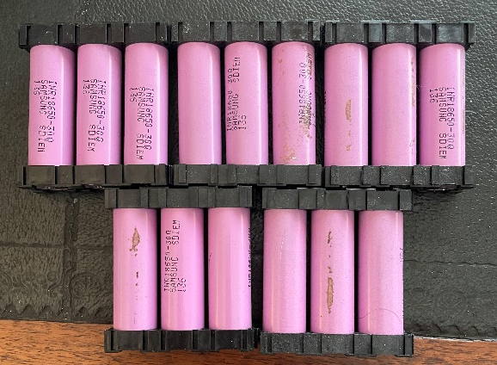
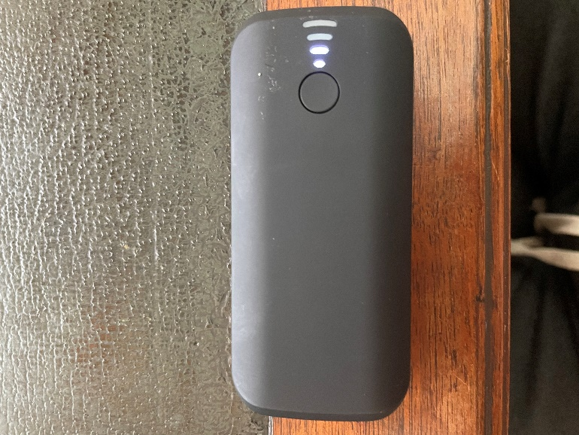
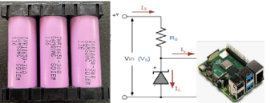
Power Consumption
TYLT WA-15TPP5200 5200 mAh power bank supplying a Raspberry Pi 3B+ running a Python implementation of TEA without parallelism.
Executing TEA on a Raspberry Pi 3B+ requires 4.82 V and 0.38 A on average.
A 5200 mAh power bank yields an approximate battery life of 13.7 hours.
18650 batteries are a great scalable solution ☺.
Approximately 29 million TEA executions can be made in the duration of the 5200 mAh power bank battery life without running any other process.
Notes:
RYAN

Slide 13
Resources
Python TEA implementation, stack overflow, https://stackoverflow.com/questions/2588364/python-tea-implementation
David Wheeler and Roger Needham, “The Tiny Encryption Algorithm (TEA)”, Cambridge Computer Laboratory
Python to assembly, Compiler Explorer, https://godbolt.org/
Convert C/C++ code to assembly language, GeeksforGeeks, https://www.geeksforgeeks.org/convert-cc-code-to-assembly-language/
Notes:
SYDNEY

